Slide 1
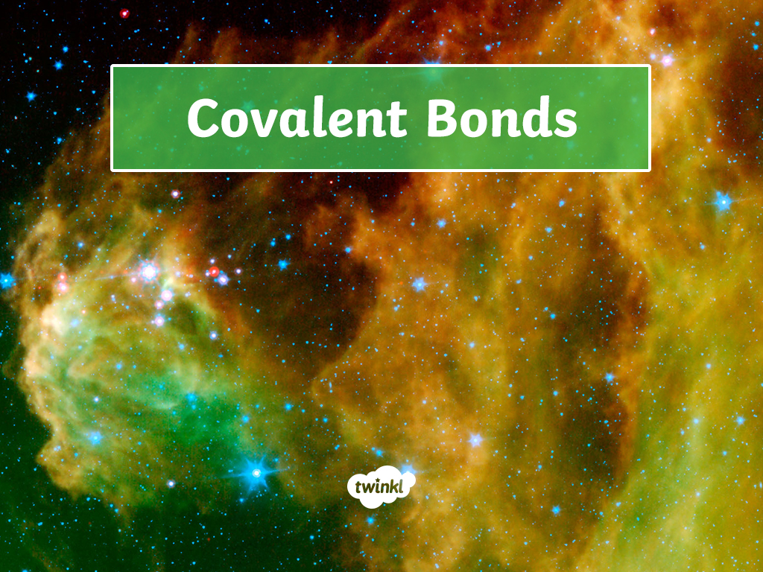


Slide 2

Learning Objective
To understand how a covalent bond is formed.
Success Criteria
To describe how a covalent bond is formed.
To draw the formation of a covalent bond in various ways.
To define the properties of simple molecules.

Slide 3
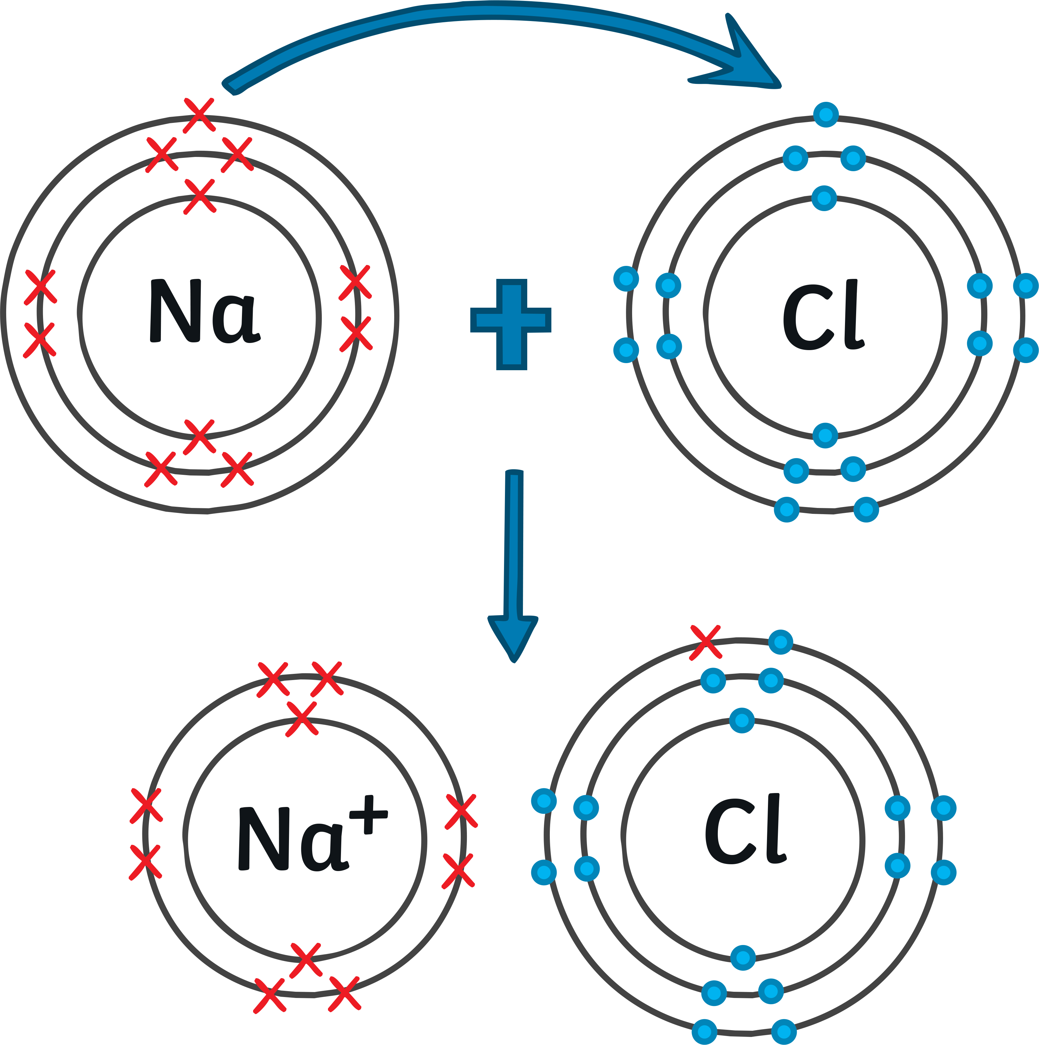
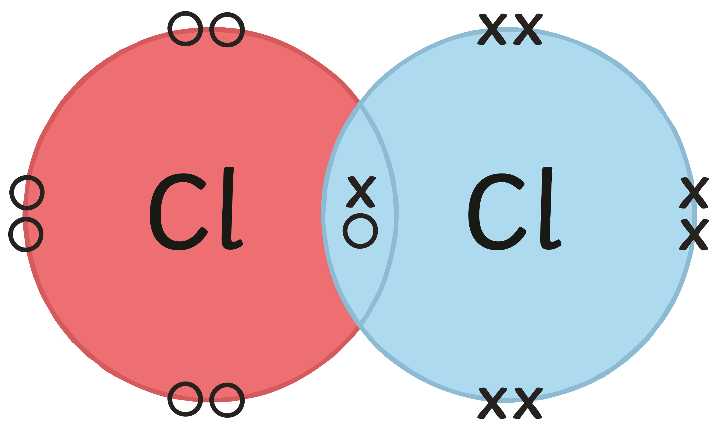
Spot The Difference
In pairs, how many differences can you spot between picture A and B?
You have 3 minutes.
Picture A
Picture B

Slide 4
Answers
Picture A
Picture B
Metal (sodium) and non-metal (chlorine).
Two atoms of a non-metal (chlorine).
Electrons are shared (where the circle overlaps).
Electrons are lost or gained.
Becomes a positive or negative ion.
No charge.

Slide 5
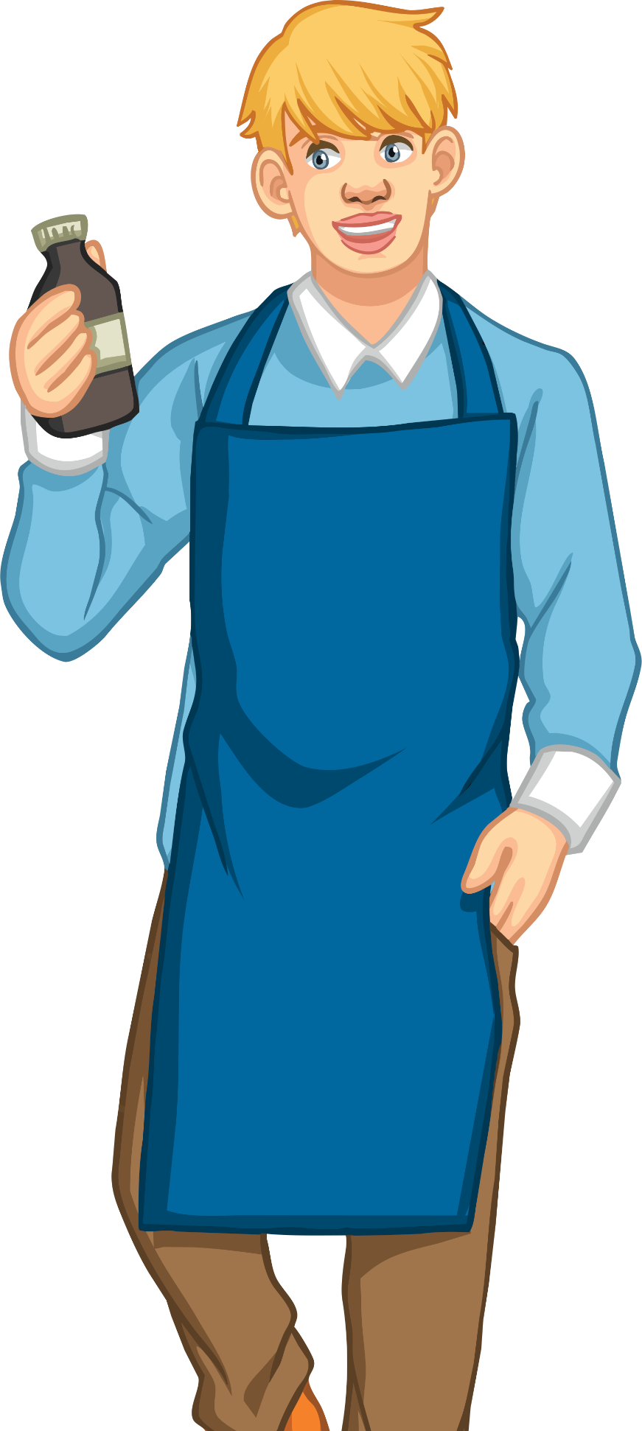
Covalent Bonding
You’ve just uncovered the basics of today’s lesson!
A covalent bond is a shared pair of electrons between atoms of non-metals.
This could be between two atoms of the same non-metal element, like you just saw with chlorine.
Or between atoms of different non-metals.

Slide 6
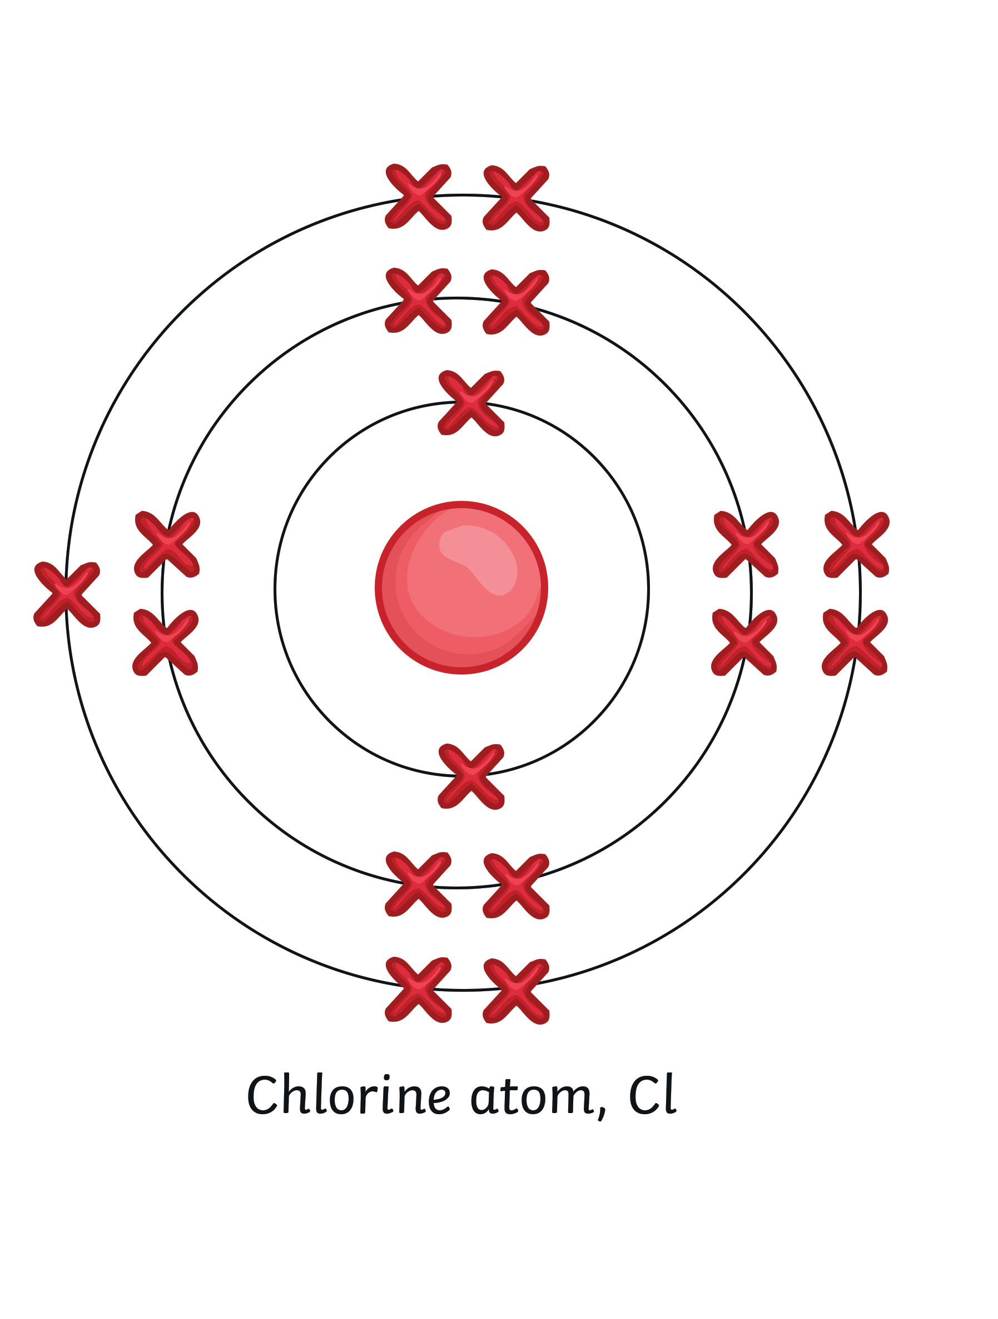
Covalent Bonding
Here is an example:
Chlorine is in group 7 on the periodic table.
To gain a full outer shell of electrons, it needs one more
(8 is a full shell – group 7 = 7 electrons).

Slide 7

Covalent Bonding
Chlorine can gain a full outer shell and thus become stable by sharing electrons.
Count the electrons on each outer shell – you should find there are eight.
Pause for Thought
Why do you think it is important to use
dots and crosses?

Slide 8
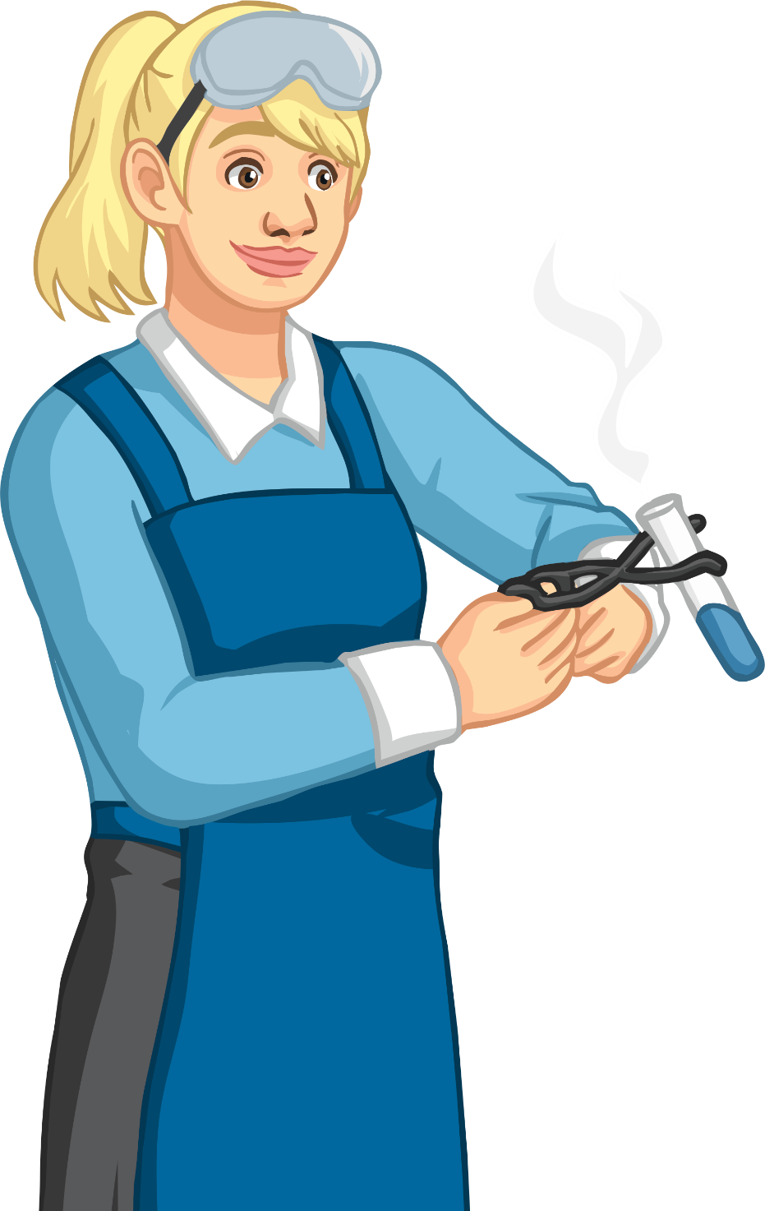
Dot and Cross Diagrams
We use dots to represent one type of atom and crosses to represent the other.
This is important so we can see which electrons are shared from which atom.
Tip: You don’t have to draw the complete
electronic configuration of each atom.

Slide 9
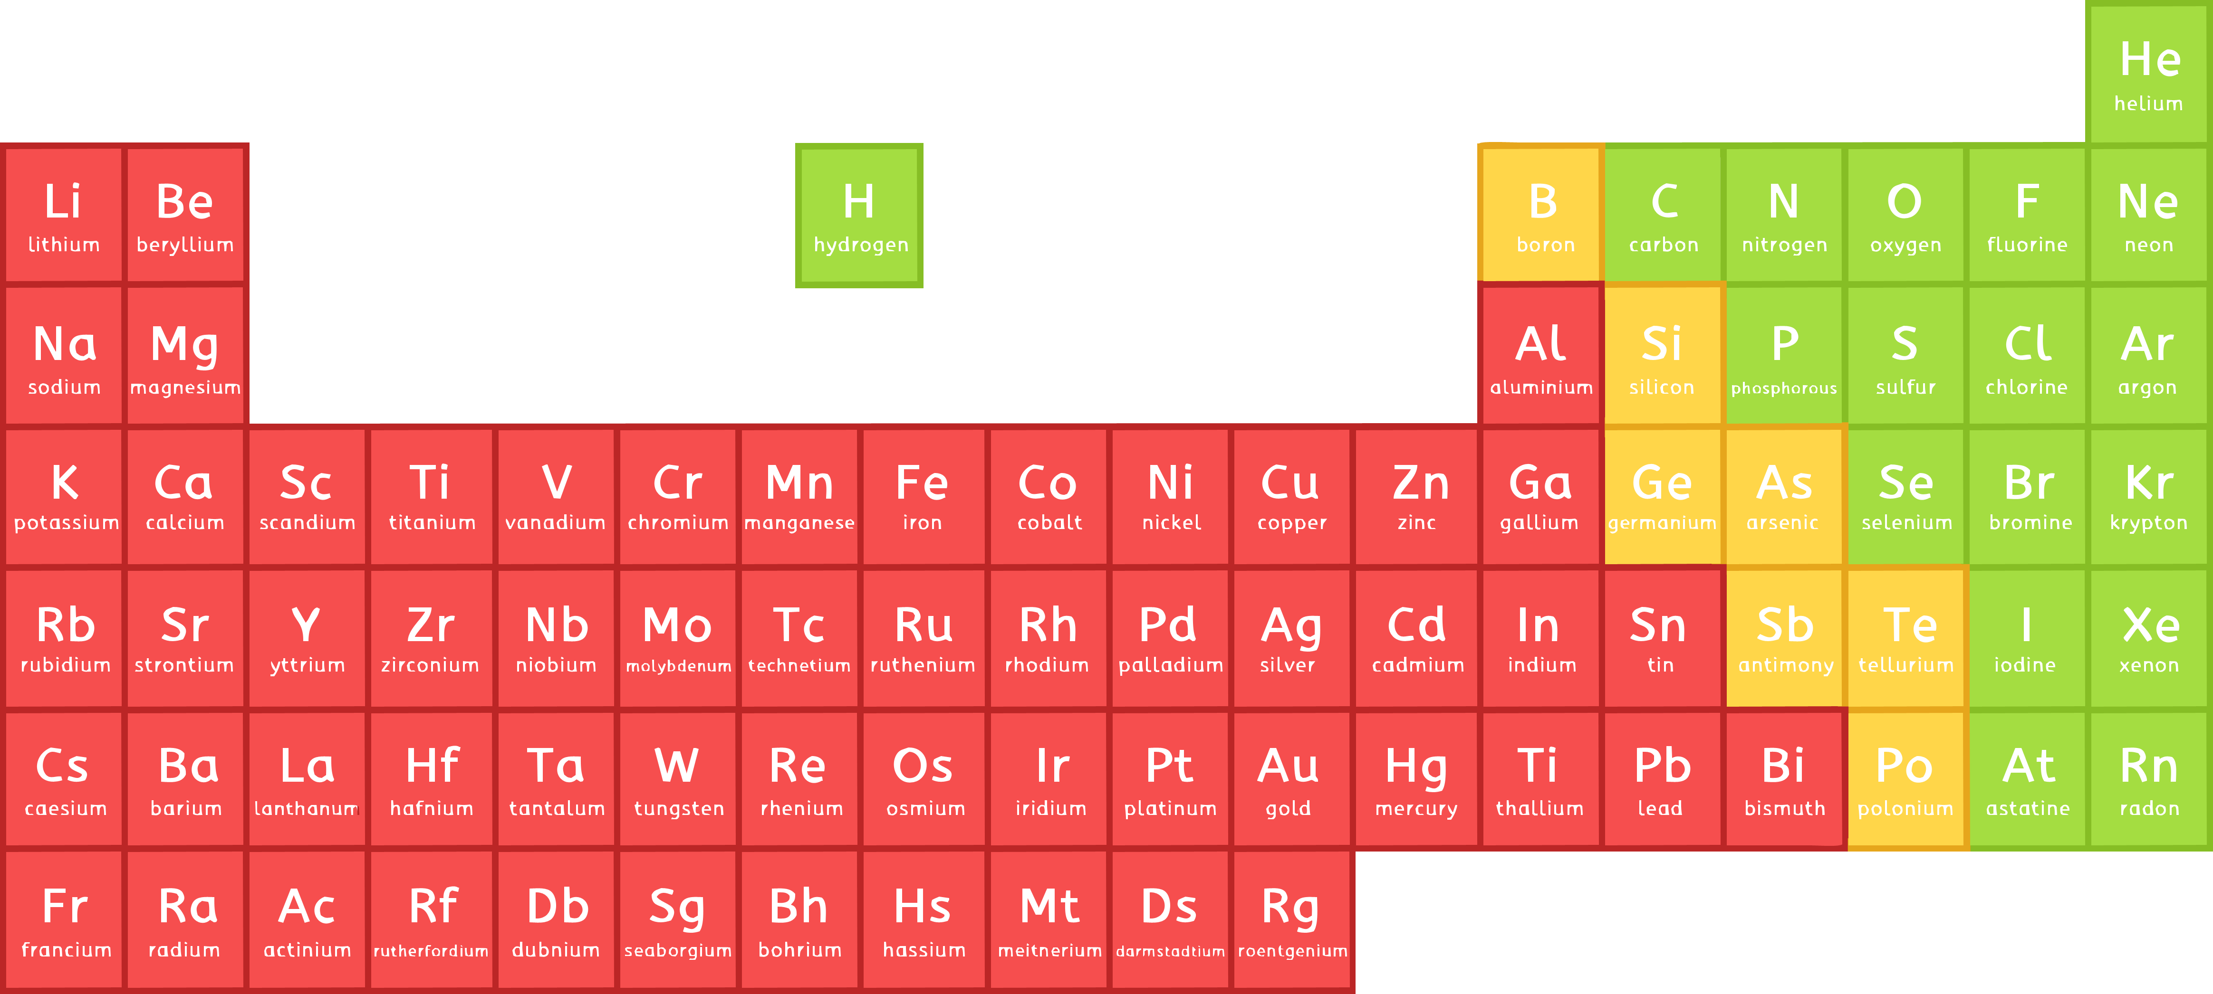
Dot and Cross Diagrams
Draw a pencil circle and write the element symbol inside.
The empirical formula should tell you how many atoms of each to draw and overlap, e.g. Cl₂.
Find the location of the element on the periodic table.
This will tell you how many electrons to draw on your circle.
Cl
Cl

Slide 10
Dot and Cross Diagrams
Choose one atom/element to be crosses and the other to be dots.
Take a moment to think how many electrons will need to be shared to create a full outer shell. They are always in pairs, but could be two pairs.
Carefully draw the electrons on your circle and in the overlap.
Tip: Try to keep your electrons in pairs at 12, 3, 6 and 9 o’clock patterns.
Cl
Cl

Slide 11

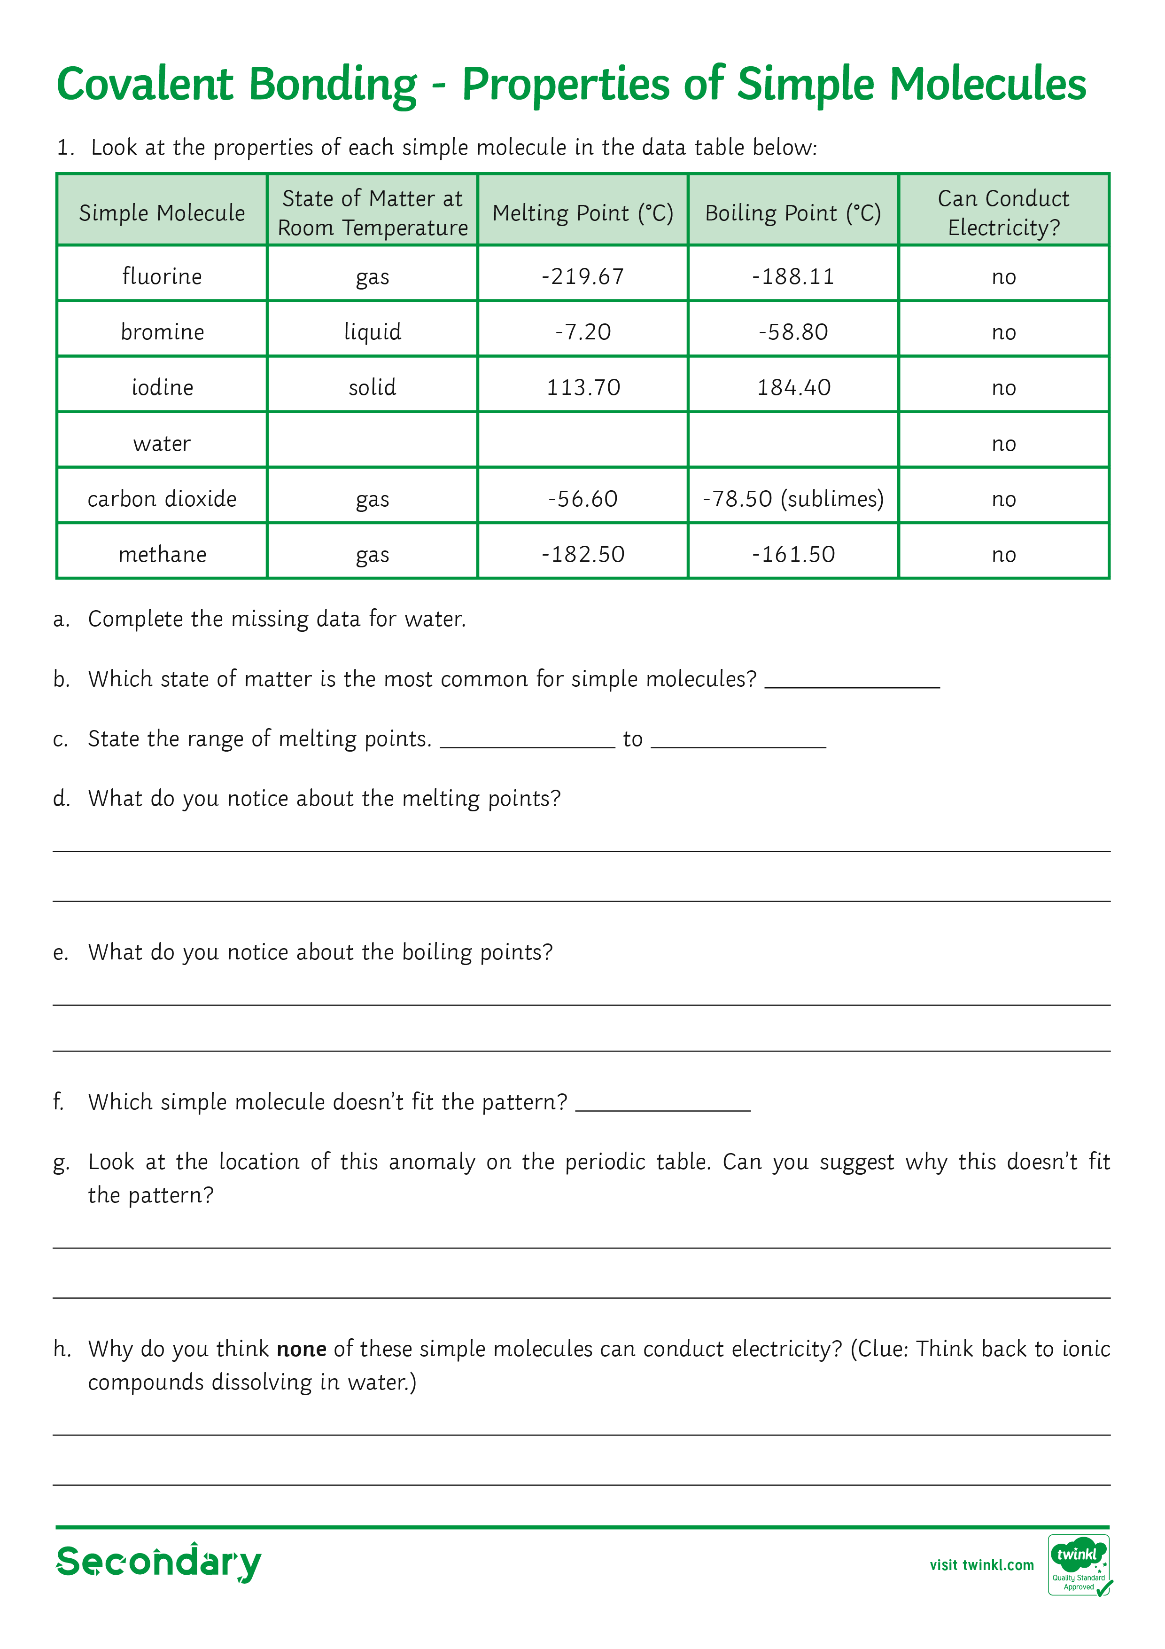
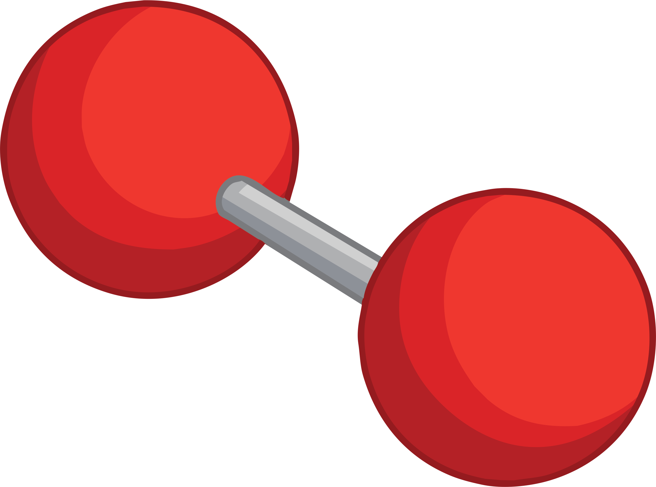
Building and Drawing Covalent Bonds Activity
Now complete the activity sheet to demonstrate your knowledge so far of covalent bonding.

Slide 12
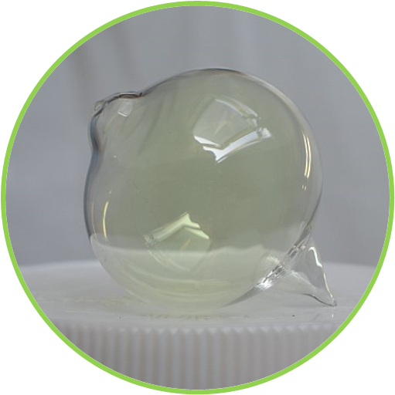
Properties of
Simple Covalent Molecules
Chlorine is named after the Greek word ‘khloros’ for ‘greenish yellow’ due to it’s colour.
Chlorine is found as a gas at room temperature.
It is very poisonous in this state of matter.
Photo courtesy of W. Oelen (@flickr.com) - granted under creative commons licence – attribution

Slide 13
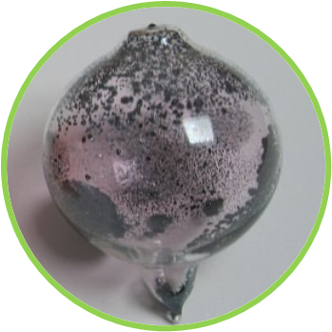
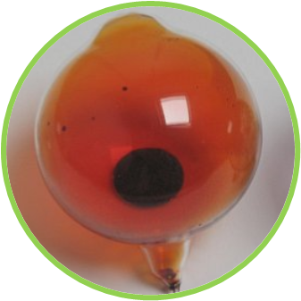
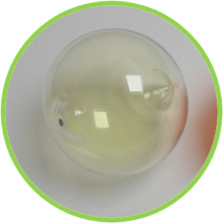
Properties of
Simple Covalent Molecules
Chlorine is found in group 7 of the periodic table, the halogens.
All halogens exist as diatomic molecules.
Fl₂, Cl₂, Br₂ and I₂
These and other simple molecules have certain properties.
Iodine
Bromine
Chlorine
Photo courtesy of W. Oelen (@flickr.com) - granted under creative commons licence – attribution

Slide 14




Keyword Definitions
Intermolecular forces are the forces between the covalently bonded molecules.
Covalent bond is the shared pair of electrons between atoms of non-metals. It creates a strong bond.
Diatomic molecules are molecules consisting of two atoms. For example, Cl₂
or O₂.
Take Notes

Slide 15
Properties of
Simple Covalent Molecules
Complete the activity sheet to identify the properties of
simple covalent molecules.
Remember, the word ‘properties’ in science means characteristics, not houses or factories!

Slide 16
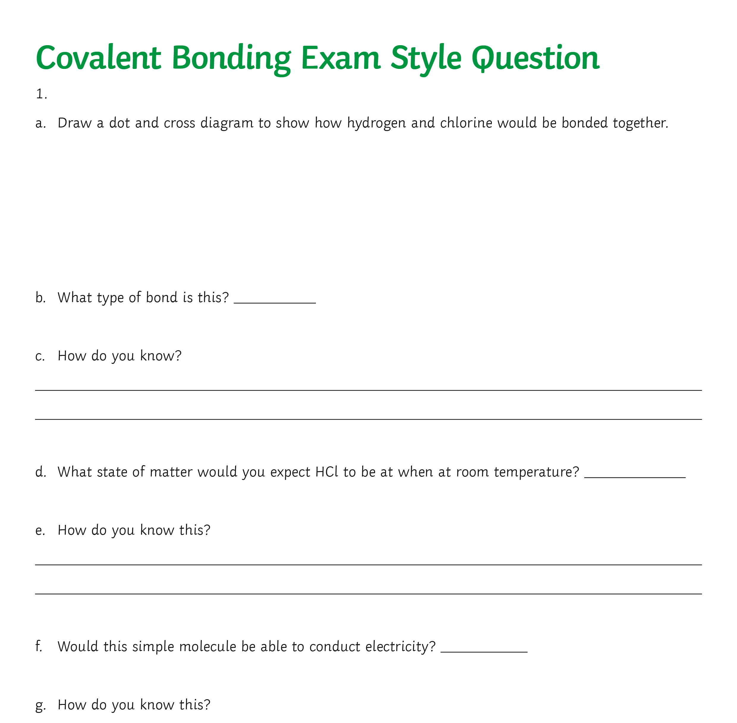
Exam Style Question
Now complete the exam style question to show your
understanding of today’s lesson.

Slide 17
What Am I?
1
2
3
I am a low, sometimes even minus, number in most simple molecules.
I am a way of drawing covalent bonds to show the electrons.
I am the type of element that exists in covalent bonds
4
5
6
I am the reason why most simple molecules are gases or liquids.
I am the number of electrons on a full shell.
I am the word to say some elements exist in pairs of atoms.
7
8
9
I am what is shared in a covalent bond.
I am the reason simple molecules cannot conduct electricity.
I am different way of drawing covalent bonds, with straight lines.

Slide 18
Answers
1
2
3
Boiling point or melting point.
I am a low, sometimes even minus, number in most simple molecules.
Dot and cross diagram.
I am a way of drawing covalent bonds to show the electrons.
non-metal
I am the type of element that exists in covalent bonds
4
5
6
Weak intermolecular forces.
I am the reason why most simple molecules are gases or liquids.
Eight, or in the first shell, only one.
I am the number of electrons on a full shell.
I am the word to say some elements exist in pairs of atoms.
diatomic
7
8
9
electrons
I am what is shared in a covalent bond.
No overall charge/no free ions.
I am the reason simple molecules cannot conduct electricity.
displayed formula
I am different way of drawing covalent bonds, with straight lines.

Slide 19
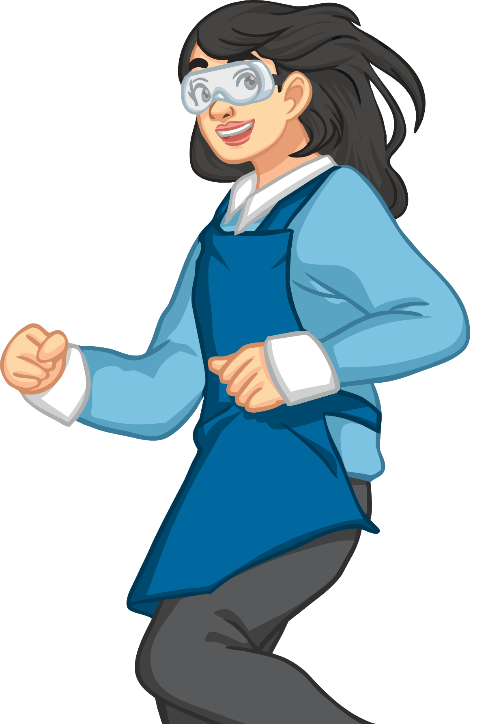
What Did You Achieve Today?
I can describe how a covalent bond is formed.
I can draw the formation of a covalent bond in various ways.
I can define the properties of simple molecules.

